Slide 1
Making Better Dirt
Five components to make us better Soil
Lesson 3
Simplicity of the Word Ministry
www.simplicityoftheword.com

Slide 2





Five Components to making us better Soil
Love God
Love Yourself and Others
Learn to Control the Tongue
Get an Understanding
See the world through the eyes of others (Compassion & Empathy)

Slide 3
Lesson 1 - Love God
“…Love the Lord thy God with all thy heart, and with all thy soul, and with all thy mind, and with all thy strength.” Mark 12:29-30
The Soul… Our feelings, emotions, our consciousness
The Mind… Our Intellect, Physical Senses
The Strength… Our actions and abilities
The Heart… The core or center of our very being
The Heart
Mind
Soul
Strength

Slide 4

Lesson 2 - Love Yourself and Others
Thou shalt love thy neighbor as thyself. Mark 12:30
Me
You
AS

Slide 5
Control the Tongue
James 3; Matthew 15:10-20
“Never pass up a good opportunity to Shut Up”

Slide 6
Taming the Tongue
Condition
  But the tongue can no man tame; it is an unruly evil, full of deadly poison. James 3:8
Cause
  But those things which proceed out of the mouth come forth from the heart; and they defile the man. Matthew 15:18
  Out of the abundance of the heart the mouth speaks. Matthew 12:34-37
Cure
  I the Lord search the heart, I try the reins, even to give every man according to his ways, and according to the fruit of his doings. Jeremiah 17:10

Slide 7
Searching Your Heart
 | Things I Know Are in My Heart | Things I Don’t Know Are in My Heart
Things Others see in My Heart
Things Others Don’t See in My Heart
Open Area: Things you and others know about your heart
Blind Spot: Things about you that you aren't aware of, but that are known by others
Open Area
Blind Spot
Facade Area: Things that you know about your heart that others don't know
Facade Area
Unknown Area
Unknown Area: Things that are unknown by you, and are unknown by others
The Johari Window (Luft, J.; Ingham, H., 1955)

Slide 8
The Heart of Biblical Leaders
At times throughout the Bible, the hearts of great, God-fearing men operated in the wrong area
  Façade - Abraham lies about Sarah (Gen 20:1-12)
  Unknown - David has Uriah killed (2 Sam 11:1-1)
  Blind Spot - Peter denies Jesus three times (Matt 26:31-35; 69-75)
  Façade - Paul’s Damascus Road Conversion (Acts 9:1-6)
However, even after making mistakes, God honored their reactions… after the actions
  Abraham continued to live by faith and God counted it as righteousness
  David repented and became a man after God’s own heart
  Peter remembered the words of Jesus, repented and became a leader
  Paul accepted Jesus as his Lord and became a great Apostle!

Slide 9
Taming the Tongue
Open Area: This is where we want to be. (John 12:35-36)
Blind Spot: We are held accountable for this area once they have been exposed by the Light. (Psalms 139:23-24)
Open Area
“The Light”
Blind Spot
“Ignorance”
Facade Area: Resolved through Humility, Submission, Repentance and Forgiveness. (James 5:16)
Unknown Area: God’s Grace and Mercy covers the “Unknown” areas of our hearts. (Jeremiah 17:9-10)
Facade Area
“Darkness”
Unknown Area
“Only God knows”
“But those things which proceed out of the mouth come forth from the heart; and they defile the man”

Slide 10
Summary
The Condition
A tongue can no man tame…
The Cause
Out of the abundance of the heart the mouth speaks…
The Cure
The Lord search the heart…
Mind
The Heart
Soul
Strength
Me
You
Thou shalt love thy neighbor as thyself. Mark 12:30
AS

Slide 11
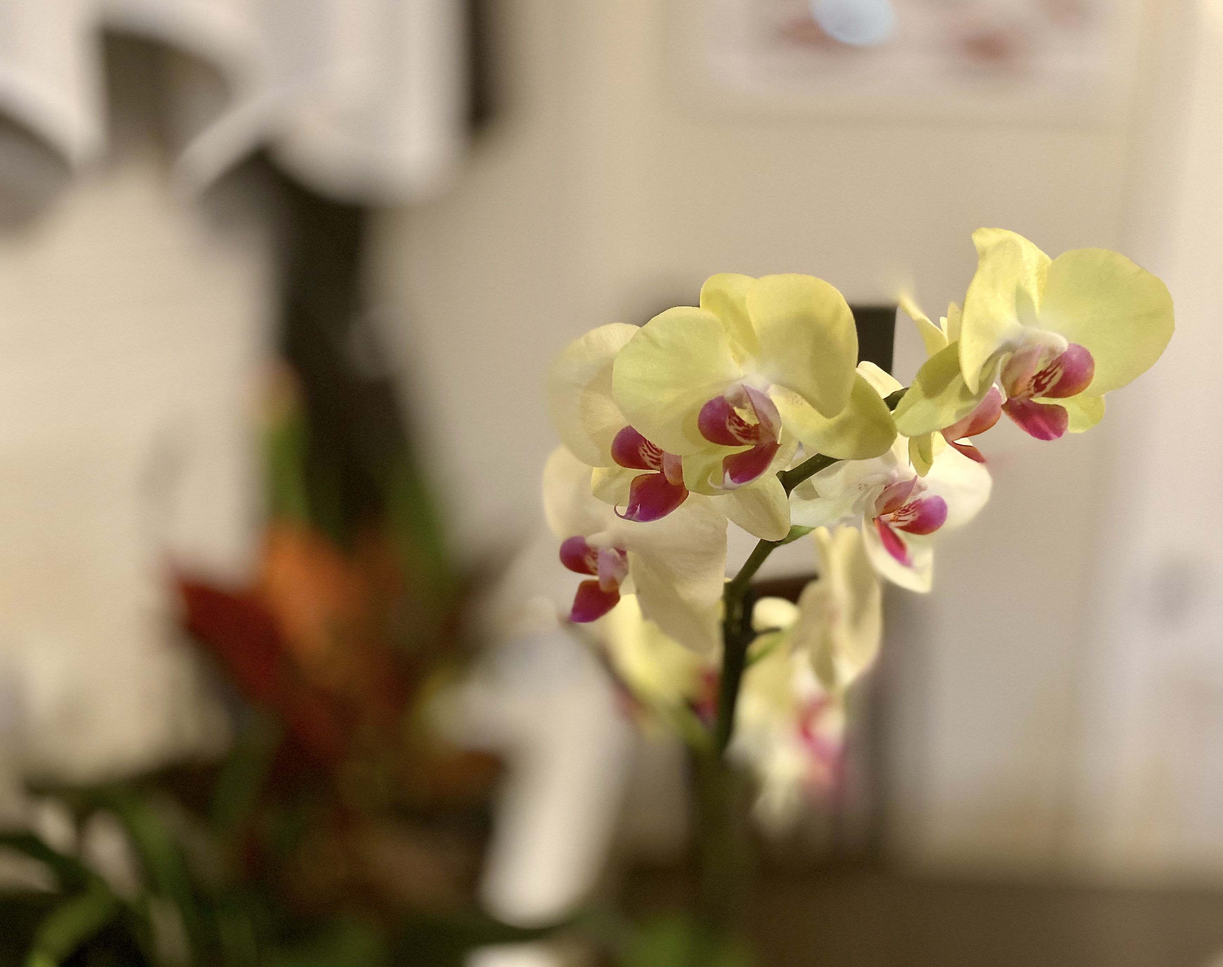
Simplicity of The Word Ministry
Larry & Aida Watlington
(757) 848-7074
(757) 848-7239
SOTW724@gmail.com
www.simplicityoftheword.com
Bible Studies/ Instructional Videos/ Original Music

